Slide 1

STANDARDS ON AUDITING
CA Abhishek S Dhamne
B.Com, FCA, DISA(ICAI), Registered Valuer(SFA)

Slide 2
Chapters for the Session
Introduction to Standards on Auditing
Brief on Quality Control of Audit and Auditing Firms :
SQC 1 : Quality Control for Firms that Perform Audit and Reviews of Historical Financial Information, and other Assurance and Related Services Engagements
SA 220 : Quality Control for an Audit of Financial Statement
Audit Trail
SA 200 : Overall Objectives of the Independent Auditor and the Conduct of an Audit in Accordance with Standards on Auditing
SA 300 : Planning an Audit of Financial Statements
SA 530 : Audit Sampling
SA 500 : Audit Evidence
SA 700 : Forming an Opinion and Reporting on Financial Statements
National Financial Reporting Authority
Role and Applicability
Case Law

Slide 3
Introduction to SAs
To ensure that information provided in the financial statements are of high quality and are acceptable worldwide the Auditing and Assurance Standards board under the council of Institute of Chartered Accountants (ICAI) have formulated few Standards.
These are in line with the International Standards issued by the International Auditing and Assurance Board (IAASB).
The basic principles for auditing standards are basic assumptions, consistent premises, logical principles and requirements which help in developing auditing standards.
Also, serve the Auditors in forming their opinions and reports, particularly in cases where no specific standards apply.

Slide 4
  Standards of Quality Control (SQCs)
  Standards on Auditing (SAs)
  Standards on Review Engagement(SREs)
  Standards on Assurance Engagements (SAEs)
  Standards on Related Services (SRSs)
Standards Issued by AASB and IAASB

Slide 5
Brief on Quality Control of Audit and Auditing Firm
SQC1 : Quality Control for Firms that Perform Audit and Reviews of Historical Financial Information, and other Assurance and Related Services Engagements

Slide 6
Understanding Quality Control in Audit and Review Engagements:
Ensures compliance with professional standards
Enhances the reliability of financial information
Maintains the credibility of the firm
Implementing quality control measures ensures that audit and review engagements are conducted in accordance with established professional standards.
Quality control processes help in ensuring the accuracy, completeness, and reliability of the financial information being audited or reviewed
Effective quality control measures demonstrate the firm's commitment to delivering high-quality services, which enhances its reputation and credibility.

Slide 7
Take Control of Quality Assurance:
Implement Effective Quality Control Systems for Audit and Review Engagements with below mentioned elements
Acceptance and continuance of client relationship and specific engagement
Human resource
Monitoring
Leadership responsibilities for quality within the firm
Relevant ethical requirements within the Firm
Engagement performance

Slide 8
Elements of an Effective Quality Control System for the Firm:
Leadership and Commitment :
i. The firm should establish policies and procedures designed to promote an internal culture based on the recognition that quality is essential in performing engagements.
ii. Top management should demonstrate a strong commitment to quality control and provide the necessary resources for its implementation.
Relevant ethical requirements :
i. The quality control system should address compliance with relevant ethical requirements, including independence and professional integrity.
ii. Fundamental Principles of Professional Ethics are :
Integrity, Objectivity, Professional Competence and due care, Confidentiality, Professional Behavior,

Slide 9
Elements of an Effective Quality Control System for the Firm :
Acceptance & continuance of client relationship & specific engagement:
i. The firm should establish policies and procedures for the acceptance & continuance of client relationships & specific engagements, designed to provide it with reasonable assurance.
ii. In considering whether the firm has the capabilities, competence, time and resources to undertake a new engagement from a new or an existing client, the firm reviews the specific requirements of the engagement and existing partner and staff profiles at all relevant levels.
Human resource:
The firm should establish policies and procedures designed to provide it with reasonable assurance that
it has sufficient personnel with the-
i. Capabilities,
ii. Competence,
iii. Commitment
Required to perform its engagements and to enable the firm or engagement partners to issue reports that are appropriate in the circumstances.

Slide 10
Elements of an Effective Quality Control System for the Firm :
Engagement performance :
i. Through its policies and procedures, the firm seeks to establish consistency in the quality of engagement performance.
ii. The firm should establish policies and procedures for dealing with and resolving differences of opinion within the engagement team, with those consulted and, where applicable, between the engagement partner and the engagement quality control reviewer.
Monitoring :
The purpose of monitoring compliance with quality control policies and procedures is to provide an evaluation of:
i. Adherence to professional standards and regulatory and legal requirements;
ii. Whether the quality control system has been appropriately designed and effectively implemented; and
iii. Whether the firm’s quality control policies and procedures have been appropriately applied

Slide 11
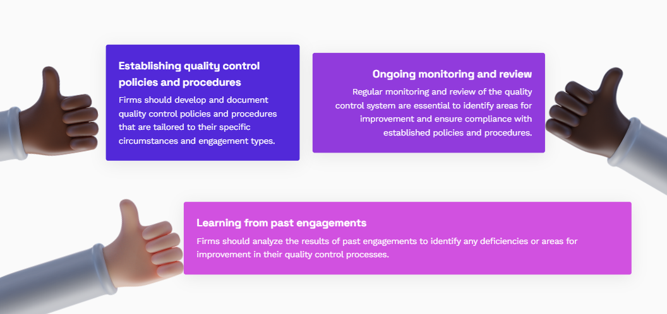
Quality Control Implementation in Practice for Audit and Review Firms:
Continuous Improvement and Monitoring of Quality Control Processes

Slide 12
Factors to consider when determining the form and content of documentation evidencing by the audit firm:
The degree of authority both personnel and offices have
The nature and complexity of the firm’s practice and organization.
The size of the firm and the number of offices.

Slide 13
Publications/study material issued by ICAI:
Publication/Material | Link
Complete text on SQC 1 | Text on SQC 1, “Quality Control for Firms that Perform Audit and Reviews of Historical Financial Information, and other Assurance and Related Services Engagements
Implementation Guide to SQC 1 | Guidance Note on SQC-1
Auditing & Assurance Standards Board | ICAI Publications

Slide 14


Brain Storming:
i. Independence required by the Code is applicable to:
a) Firm and Firm's personnel
b) Network firm personnel
c) Experts contracted by the firm
d) All of the above
ii. What consideration should be exercised before acceptance or re-acceptance of a
client relationship or specific engagement?
a) Business reputation of client's principal owners, key management, related
parties and those charged with governance
b) Limitation on the scope of work and involvement, if any, in money laundering
activities
c) Reason for proposed appointment of the firm and non-reappointment of the
previous firm
d) All of the above

Slide 15

Brief on Quality Control of Audit and Auditing Firm
SA 220 : Quality Control for an Audit of Financial Statements

Slide 16
Objective of SA 220 :
SA 220 sets out the requirements and guidance for quality control for audits of financial statements.
Its purpose is to ensure that the audit is performed with the highest level of quality
Auditor maintains and applies appropriate quality control procedures throughout the audit engagement.
The objective of the auditor is to implement quality control procedures at the engagement level that provide the auditor with reasonable assurance that
System of Quality Control and Role of Engagement Teams :
Quality control systems, policies and procedures are the responsibility of the audit firm.
The firm and its personnel comply with professional standards and regulatory and legal requirements; and
The reports issued by the firm or engagement partners are appropriate in the circumstances
This SA is premised on the basis that the firm is subject to SQC 1

Slide 17
Elements of Quality Control in Audits of Financial Statements:
Sr No. | Elements | Description
1. | Leadership Responsibilities | The firm's leadership is responsible for establishing and maintaining a culture of quality and ethical behavior, as well as promoting and ensuring compliance with relevant professional standards.
2. | Relevant Ethical Requirements | Auditors must comply with relevant ethical requirements, including independence, integrity, objectivity, confidentiality, and professional competence and due care.
3. | Acceptance and Continuance of Client Relationships and Specific Engagements | Auditors must evaluate and document the appropriateness of accepting or continuing client relationships and specific audit engagements, considering factors such as the integrity of the client, the firm's ability to perform the engagement, and compliance with relevant ethical requirements.

Slide 18
Elements of Quality Control in Audits of Financial Statements:
Sr No. | Elements | Description
4 | Human Resources | Firms must have sufficient and appropriately trained personnel with the necessary competence, capabilities, and commitment to ethical principles to perform audits of financial statements.
5. | Engagement Performance | The audit engagement must be performed by individuals with the necessary competence, capabilities, and commitment to ethical principles. The engagement team should plan and perform the audit to obtain reasonable assurance about whether the financial statements are free from material misstatement.
6. | Monitoring | Firms must establish and maintain a system of quality control to provide reasonable assurance that the firm and its personnel comply with professional standards and applicable legal and regulatory requirements, and that the reports issued by the firm or engagement partners are appropriate in the circumstances.
7. | Documentation | Firms must maintain sufficient documentation to provide a clear and complete record of the basis for the auditor's report and evidence that the audit was performed in accordance with relevant professional standards.

Slide 19
Responsibilities of the Engagement Partner:
The engagement partner is responsible for overseeing the quality control of audits of financial statements.
They ensure that the audit is conducted in accordance with relevant auditing standards and regulatory requirements.
The engagement partner reviews and approves the audit plan, ensuring that it addresses the risks and objectives of the engagement.
They supervise the audit team, providing guidance and support throughout the engagement.
Maintaining Quality Control

Slide 20
Brain Storming:
i. The engagement partner need not review all audit documentation, but may do so.
However, as required by SA 230, the partner documents the extent and timing of
the review.
a) True
b) False
ii. The engagement partner shall form a _______on compliance with independence
requirements that apply to the audit engagement.
a) Conclusion
b) Opinion

Slide 21
Audit Trail
SA 200 : Overall Objectives of the Independent Auditor and the Conduct of an Audit in Accordance with Standards on Auditing

Slide 22
Scope of SA 200 :
Independent auditor's overall responsibilities when conducting an audit of financial statements in accordance with SAs.
It sets out the overall objectives of the independent auditor, nature and scope of an audit.
Objective of the Auditor :
To obtain reasonable assurance about whether the financial statements as a whole are free from material misstatement, whether due to fraud or error
To report on the financial statements & communicate as required by the SAs, in accordance with the auditor's findings
In case reasonable assurance cannot be obtained & qualified opinion is insufficient - Disclaimer of opinion/ withdraw from the engagement.
In case of failure to achieve either relevant objectives or overall objectives then Auditor should think to modify the opinion or withdraw from the engagement.

Slide 23
The Auditor’s Responsibility :
Thorough Examination
Fraud Detection
Impartial Opinion
Auditors provide an unbiased assessment of a company's financial health, offering assurance to stakeholders.
An independent auditor is responsible for carefully examining a company's financial statements to ensure accuracy and compliance.
Auditors play a vital role in detecting any potential fraud or misrepresentation within the financial records.

Slide 24
/
Planning
Establishing the audit scope, objectives, and methodologies
Fieldwork
Gathering evidence through interviews, observations, and examination of documents.
Reporting
Summarizing findings and issuing an audit report with recommendations if necessary.
Elements of an Audit :

Slide 25
Requirement of SA 200 :
Ethical Requirements
Sufficient & Appropriate Audit Evidence
Professional Judgement
Professional Skepticism.
Sufficiency refers to Quantity & Appropriateness refers to Quality of Audit Evidence.

Slide 26
Brain Storming:
i. An internal control which is well designed and operating would eliminate the risk of
material misstatement in the financial statements.
a) True
b) False
ii. Professional judgment and professional skepticism shall be exercised by the
auditor during:
a) Identifying and assessing the risk of material misstatement
b) While forming an opinion based on conclusion drawn
c) While obtaining sufficient and appropriate audit evidence
d) All of the above

Slide 27
Audit Trail
SA 300 : Planning an Audit of Financial Statements

Slide 28
Scope of SA 300 :
SA 300 deals with the auditor’s responsibility to plan an audit of financial statements. This SA is framed in the context of recurring audits. Additional considerations in initial audit engagements are separately identified.
Objective of SA 300 :
The objective of the auditor is to plan the audit so that it will be performed in an effective manner.
Activities before starting the Audit :
Perform Client Acceptance procedures as per SA 220
Communicate with predecessor auditor as per ethical requirements.
The engagement partner & other key members of the engagement team shall be involved in planning & discussion of the audit.

Slide 29
/
Performing procedures required by SA 220 regarding the continuance of the client relationship and specific audit engagement.
01
Evaluating compliance with the ethical requirements, including independence, as required by SA 220
02
Establishing an understanding of the terms of the engagement, as required by SA 210.
03
Preliminary Engagement Activities :

Slide 30
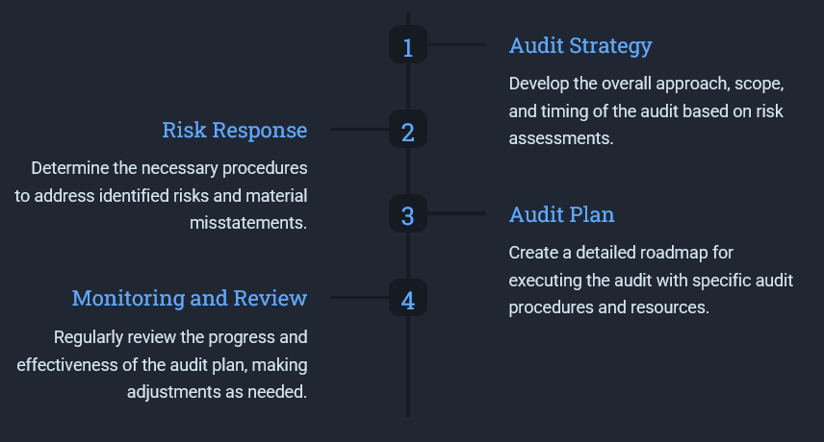
Audit Strategy and Audit Plan :

Slide 31
Establish overall audit strategy that defines nature, timing and extent of an audit. For that :
Consider factors of Professional Judgement which can direct / guide team
Ascertain reporting objectives and NTE of communication required,
Identify scope, nature and characteristics of engagement
Consider the results of preliminary engagement activities
Planning Activities :
Define NTE of resources and team
Other procedures planned as per other SAs
Develop Audit Plan (that shall include NTE of planned risk assessment procedure and further audit procedure)
Plan NTE of direction and supervision of team and review of work
Update and change, as necessary, the overall audit plan

Slide 32
Control Environment :
Evaluate the tone set by management, the oversight provided by the board, and the company's ethical values
Control Activities :
Assess the specific procedures and policies designed to ensure accurate financial reporting.
Information & Communication
Preliminary Assessment of Internal Control :

Slide 33
Audit Documentation :
The Auditor shall document :
The audit plan; and
Any significant changes made during the audit engagement to the overall audit strategy or the audit plan, and the reasons for such changes
The overall audit strategy;

Slide 34
Brain Storming:
i. The establishment of the overall audit strategy and the detailed audit plan are not
necessarily discrete or sequential processes, but are closely inter-related since
changes in one may result in consequential changes to the other.
a) True
b) False
ii. Planning is a discrete phase of an audit which often begins shortly after the
completion of the previous audit and ends before the commencement of the
current audit engagement.
a) True
b) False

Slide 35

Audit Trail
SA 530 : Audit Sampling

Slide 36
Scope of SA 530 :
SA 530 applies when the auditor has decided to use audit sampling in performing audit procedures
Auditor’s use of statistical and non-statistical sampling when designing and selecting the audit sample
Performing tests of controls and tests of details, and evaluating the results from the sample
This SA compliments SA 500- Audit Evidence.
Objective of SA 530 :
The objective of the auditor when using audit sampling is to provide a reasonable basis for the auditor to draw conclusions about the population from which the sample is selected.

Slide 37
Sample Design, Size and Selection of Items for Testing :
Designing Audit Sample
Consider the purpose of the Audit Procedures
Characteristics of the Population
Sample Size
Sufficient to reduce Sampling Risk
Selection of Items
Each sampling unit in the population has a chance of Selection

Slide 38
Risks :
Effectiveness of Test of Controls & Test of Details of the sample with respect to the Population
Non Sampling Risk
The risk that the auditor reaches an erroneous conclusion for any reason not related to sampling risk
More Effective
Less Effective
affects audit effectiveness and
affects audit efficiency
as it would usually lead to additional work to establish that initial conclusions were incorrect
Sampling Risk
is more likely to lead to an inappropriate audit opinion

Slide 39
Nature & Causes of Deviations & Misstatement :
Auditor shall investigate the nature and cause of any deviations or misstatements identified
Evaluate their possible effect on the purpose of the audit procedures
Nature and Cause of Deviations and Misstatements
Evaluating the Results of Audit Sampling :
Auditor shall evaluate
The results of the sample &
Whether the use of audit sampling has provided a reasonable basis for conclusions about the tested population.

Slide 40
Brain Storming:
i. __________________ approach to sampling has the following characteristics:
I. Random selection of the sample items; and
II. The use of probability theory to evaluate sample results, including
measurement of sampling risk.
Solution:
a) Statistical sampling
b) Random sampling
c) Stratified sampling
d) Haphazard sampling
ii. When designing audit sample, auditor is required to consider the ________of
population.
a) Objective
b) Characteristics

Slide 41
Audit Trail
SA 500 : Audit Evidence

Slide 42
1. Design and perform audit procedures
3. Draw reasonable conclusions on which to base the auditor’s opinion
Scope of SA 500
2. To obtain sufficient & appropriate audit evidence

Slide 43
Sufficient & Appropriate Audit Evidence :
Measure of Quantity
Measure of Quality
Appropriateness
Sufficiency
The sufficiency and appropriateness of audit evidence are interrelated.
The sufficiency of audit evidence needed is affected by the auditor’s assessment of the risks of misstatement
Also by the Appropriateness of such audit evidence (the higher the quality, the less may be required).
Obtaining more audit evidence, however, may not compensate for its poor quality.

Slide 44
Audit Procedures to obtain Audit Evidence :
Inspection
Observation
Confirmation
Reperformance
Recalculation
Examining records or documents
Looking at a process performed by others
External Confirmation
Checking of Mathematical Accuracy of records
Analytical Procedures
Independent execution of procedures or controls of Entity
Evaluations of financial information made by a study of plausible relationships

Slide 45
Audit Procedures to obtain Audit Evidence
Risk Assessment Procedures
Test of Controls
Further Assessment Procedures
Test of Details

Slide 46
Brain Storming:
i. Absence of information (for example, management’s refusal to provide a
requested representation) also constitutes an audit evidence in some cases.
a) True
b) False
ii. Audit evidence to draw reasonable conclusions on which to base the auditor’s
opinion is obtained by performing __________ and __________.
a) Test of controls; physical verification
b) Test of details; risk assessment procedures
c) Risk assessment procedures; further audit procedures
d) Test of control; analytical review

Slide 47
Audit Trail
SA 700 (Revised) : Forming an Opinion and Reporting on Financial Statements

Slide 48
Scope of SA 700 (Revised) :
Auditor’s Responsibilities to form an Opinion on Financial Statements
Form and content of the Auditor’s Report issued as a result of an audit of financial statements.
Aimed at addressing an appropriate balance between the need for consistency and comparability in auditor reporting globally and the need to increase the value of auditor reporting by making the information provided in the auditor’s report more relevant to users.
Objectives of SA 700 (Revised) :
To form an opinion on the financial statements based on an evaluation of the conclusions drawn from the audit evidence obtained
To express clearly that opinion through a written report

Slide 49
Forming an Opinion :
Whether the financial statements are prepared, in all material respects, in accordance with the applicable financial reporting framework
The auditor shall conclude as to whether the auditor has obtained reasonable assurance about whether the financial statements as a whole are free from material misstatement, whether due to fraud or error.
This evaluation shall include consideration of the qualitative aspects of the entity’s accounting practices, including indicators of possible bias in management’s judgments

Slide 50
Types of Opinion :
Opinion
Unmodified Opinion
Modified Opinion
Qualified Opinion
Disclaimer Of Opinion
Adverse Opinion

Slide 51

Basis of Modified Opinion:
Nature of Matter giving rise to the modification | Auditor’s judgement about the pervasiveness of the effects or possible effects of the matter on financial statements Material But not Pervasive | Auditor’s judgement about the pervasiveness of the effects or possible effects of the matter on financial statements Material but Pervasive
Financial Statements are materially misstated | QUALIFIED OPINION | ADVERSE OPINION
Inability to obtain sufficient and appropriate audit evidence | QUALIFIED OPINION | DISCLAIMER OF OPINION

Slide 52
/
Title
Addressee
Auditor’s Opinion
Basis for Opinion
Going Concern
Key Audit Matters
Management's
Responsibilities for the Financial Statements
Auditor’s Responsibilities for the audit of financial statements
Other Reporting Responsibilities
Signature of the Auditor
Place of Signature
Date of the Auditor’s Report
Audit Report
Components

Slide 53
Brain Storming:
i. Does the requirement of SA 700(Revised) apply for the review engagements of
financial statements/financial results for the period commencing on or after 1 April
2018?
a) Yes, auditor should comply with requirements of SA 700 for all engagements
including review engagements.
b) No, auditor should comply with the requirements of review standards SRE
2400 or SRE 2410 as may be applicable. SA 700(Revised) does not apply to
review engagements.
ii. Can an auditor sign the auditor’s report at a place other than the place where the
registered office of the entity is situated?
a) No, place of signature should be the same location where the registered
office of the entity is situated.
b) Yes, an auditor can sign at a place which is different from the registered
office of the entity and ordinarily, location as per SA 700 (Revised) is the
place where audit report is signed.

Slide 54
National Financial Reporting Authority
  Role and Applicability
  Case Laws

Slide 55
Role of NFRA
Make recommendations on the foundation and laying down of accounting and auditing policies and standards
Monitor and enforce the compliance of the accounting standards and auditing standards
Oversee the quality of service of the professionals (such as auditors, CFOs, etc.) and suggest measures required for improvement in the quality of service
Perform such other functions related to the above

Slide 56
Applicability of NFRA
Foreign Companies
Any body corporate registered in India or not referred as earlier having subsidiary/ associate/ Body Company incorporated outside India, if the income or net worth of such subsidiary/ associate exceeds 20% of Consolidated Income/ Net worth.
Indian Companies
Listed Companies
Unlisted Public Companies having
Paid up Share Capital of Rs. 500 Cr.
Turnover of Rs. 1,000 Cr.
Outstanding Loans, Debentures, Deposits in aggregate of Rs. 500 Cr.
Insurance Companies,
Any Body Corporate or Company on a reference made by government in public interest
Following Kinds of Companies :
Banking Companies,
Companies engaged in generation & Supply of Electricity,
Companies governed by any other Act

Slide 57
Case Law :
NFRA imposes monetary penalty of Rs. 1.10 Crore on Auditors of Coffee Day Enterprises Ltd :
Background of the Case :
  SEBI shared its investigation regarding diversion of funds worth Rs. 3,535 crores from 7 subsidiary companies of Coffee Day Enterprises Limited to Mysore Amalgamated Coffee Estate Limited (entity owned by promoters of CDEL).
  Giri Vidhyuth (India) Limited (‘GVIL’) was one of the companies used for such diversion of funds with M/s (Firm) as their Statutory Auditor.
  NFRA, on examining the Audit File of GVIL, issued a show cause notice asking them why the penal provisions under Section 132(4)(c) of the Companies Act, 2013 should not be invoked for professional misconduct.

Slide 58
Professional Misconduct
Failure to disclose a material fact known to the Auditors.
Failure to report a material misstatement known to the Auditors.
Failure to exercise due diligence.
Failure to obtain sufficient information.
Failure to invite attention of any material departure.

Slide 59
Major Lapses in the Audit
The Auditors were in non-compliance with requirements relating to independence of the Auditor
Failure on the part of Auditors as they were unable to understand the nature of GVIL including its operations, ownership and governance structures, types of investments GVIL was making, and it was financed
Violation of Code of Ethics, as the professional fees received by the Auditors from CDEL including its promoters, exceeded the maximum threshold of 40% of the total professional fees
Failure to evaluate management’s assessment of the entity’s ability to continue as going concern
Failure to report material misstatements of Rs. 325 crores in Statement of Cash Flows

Slide 60
Conclusion Drawn by NFRA:
NFRA held that the Auditors have committed Professional Misconduct, and all the charges stand proved.
Penalty & Sanctions:
  M/s (Firm) – Rs. 1,00,00,000/- and Debarred for 2 years from being appointed as auditor.
  The 2 Chartered Accountants- Rs. 5,00,000/- each and Debarred for 5 years from being appointed as auditor.

Slide 61
You do not rise to the level of your goals, but you fall to the level of your system
- James Clear

Slide 62
Thank you!!!
abhishekdhamne@ssdca.in
+91 9890 541551

